Slide 1

UNIT 6
LEGAL AND ETHICAL ISSUES IN COMPUTER SECURITY
By Swati(24833)

Slide 2
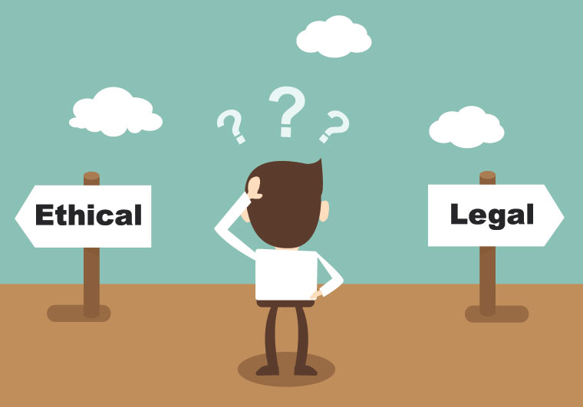
LEGAL AND ETHICAL???
LAW is made by judicial system of country.
Ethics mean a moral philosophy that guides us about what is good or bad.
Example of activities:-
  Legal & ethical
  illegal & ethical
  illegal & unethical

Slide 3
THIS CHAPTER EXAMINES…
Program and data protection by patents, copyrights, and trademarks
Computer crime
Ethical analysis of computer security situations
Codes of professional ethics

Slide 4
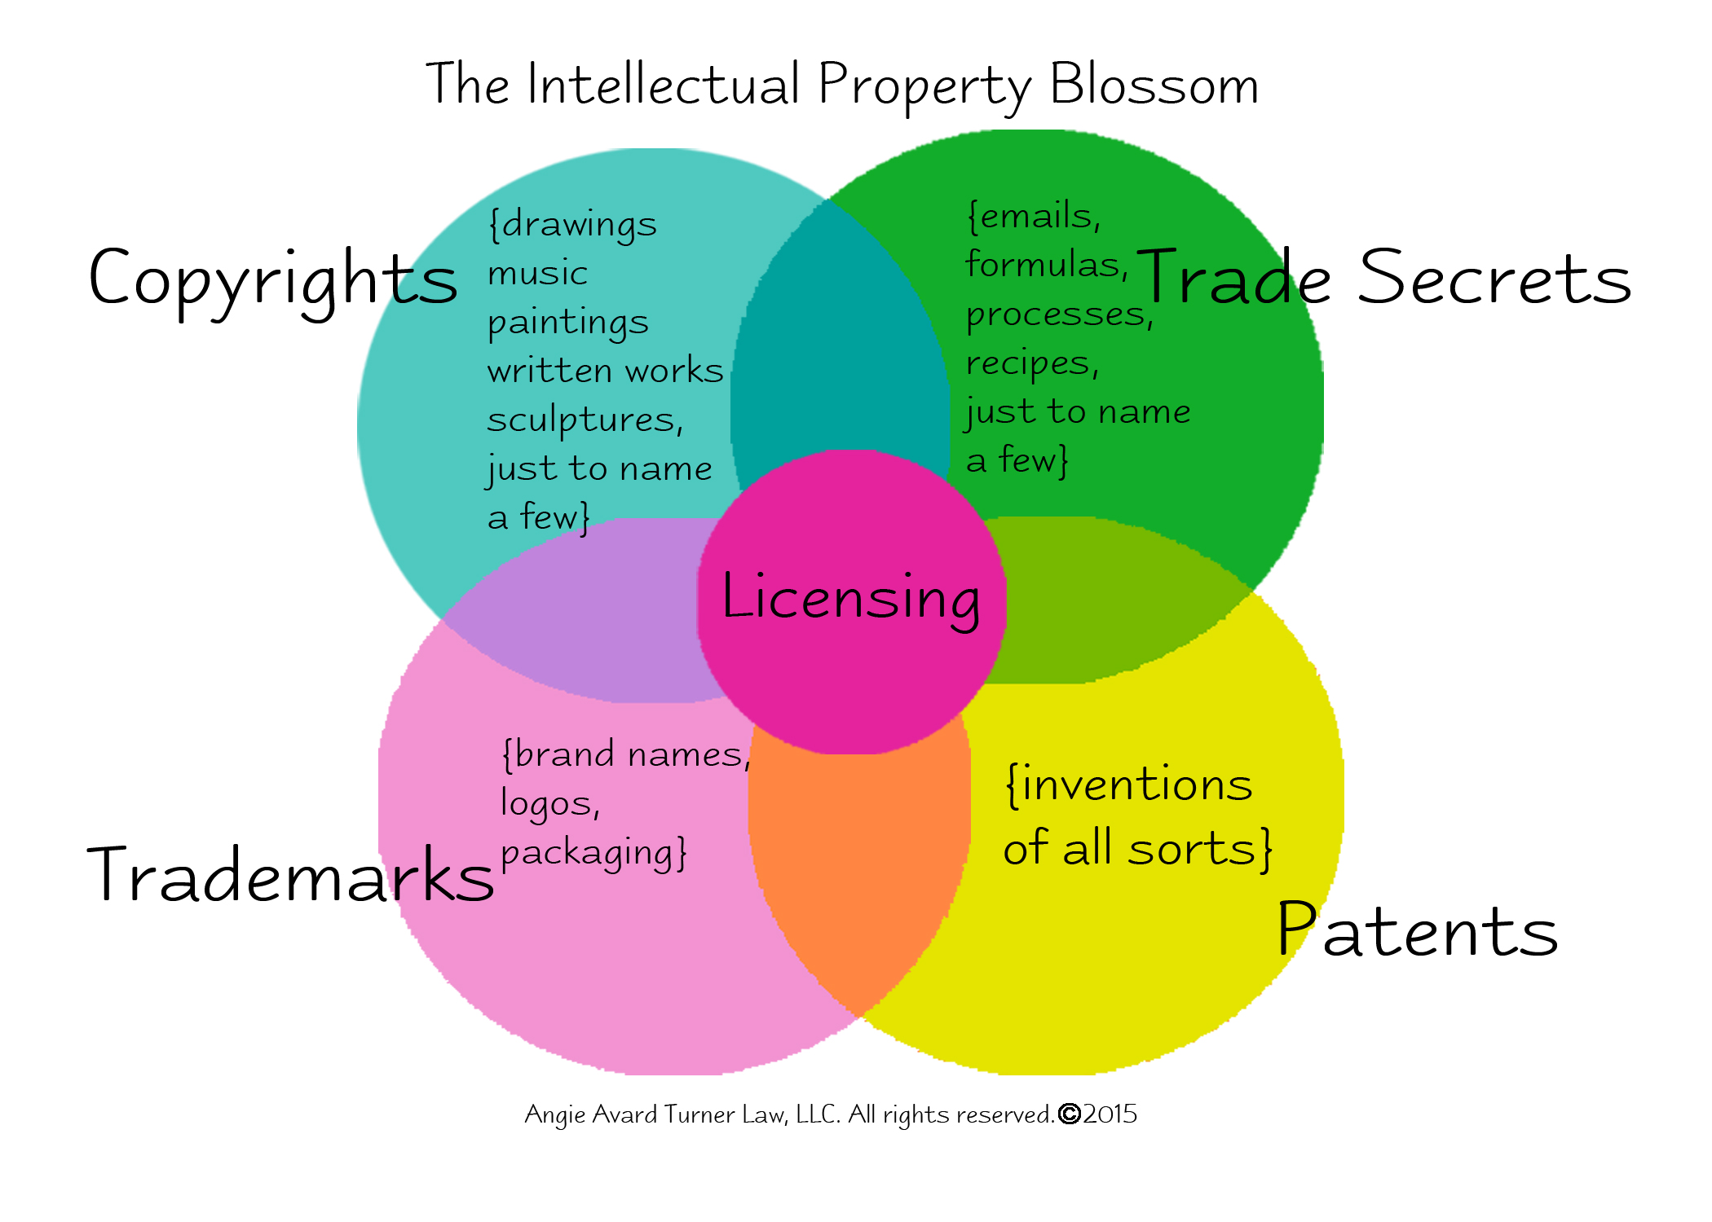
PROTECTING PROGRAMS AND DATA
Common legal devices include:
Copyrights
Patents
Trademark
Trade Secrets

Slide 5
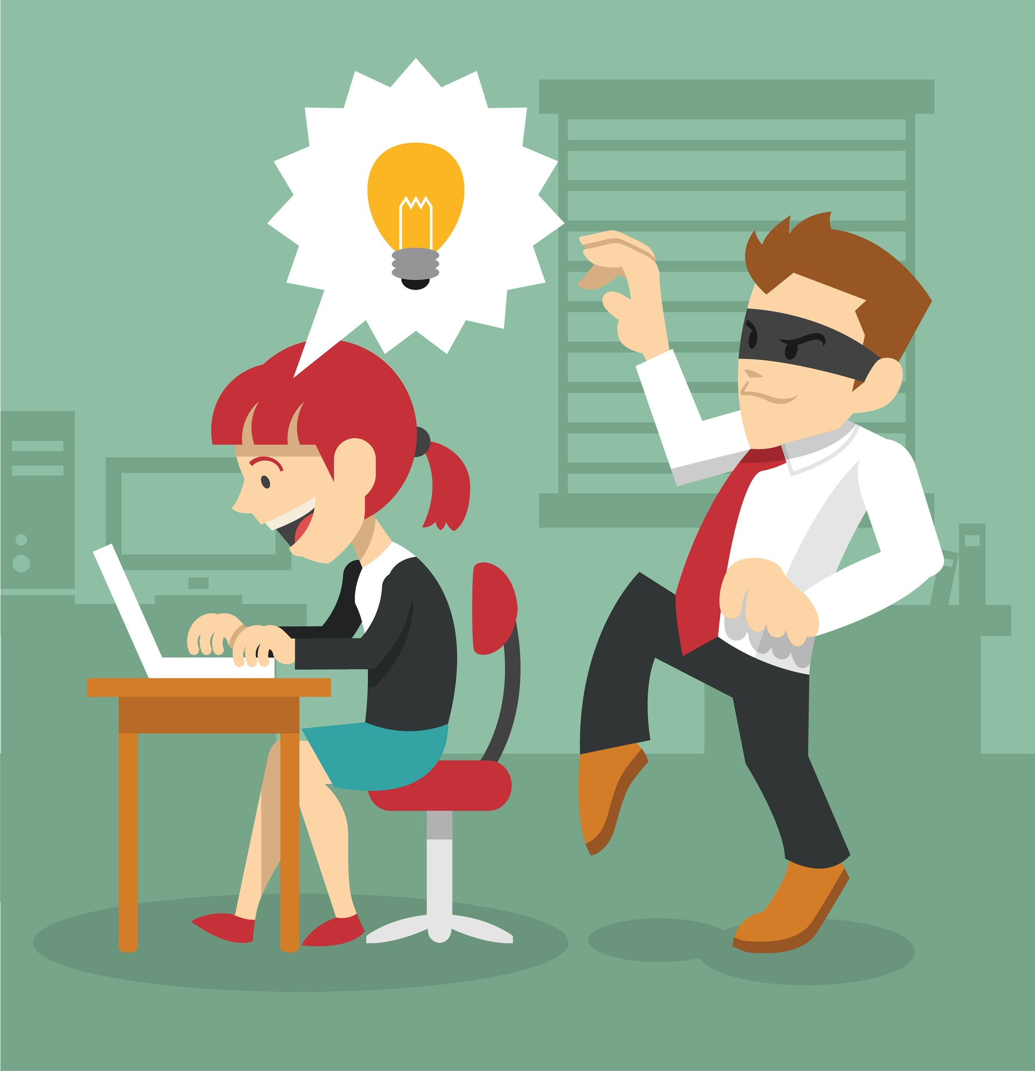
COPYRIGHTS
Copyright is a legal means of protecting an author's work. It is a type of intellectual property that provides exclusive publication, distribution, and usage rights for the author.
Intention of a copyright is to allow regular and free exchange of ideas
Gives the author the exclusive right to make copies of the expression and sell them to the public

Slide 6
CONT…
Copyright must apply to original work
It lasts for few years after which it is considered public domain
Copyright object is subject to fair use
  Product used in a manner for which it was intended and does not interfere with the author’s rights, e.g. comment, criticism, teaching, scholarly research
  Unfair use of copyrighted object is called piracy
Piracy refers to the unauthorized duplication of copyrighted content that is then sold at substantially lower prices in the 'grey' market.

Slide 7

WHAT DOES A COPYRIGHT PROTECT???
literary works
musical works, including any accompanying words
dramatic works, including any accompanying music
pictorial, graphic, and sculptural works
motion pictures and other audiovisual works
sound recordings
architectural works

Slide 8
COPYRIGHTS FOR COMPUTER SOFTWARE
Algorithm is the idea, and the statements of the programming language are the expression of the idea
Protection is allowed for the program statements themselves, but not for the algorithmic concept
Copying the code intact is prohibited, but re-implementing the algorithm is permitted

Slide 9
PATENTS
A patent is a grant of property rights to an invention.
Patents were intended to apply to the results of science, technology, and engineering
A patent can be valid only for something that is truly novel or unique – usually one patent for a given invention

Slide 10
PATENT INFRINGEMENT
Patent infringement occurs when another party makes, uses, or sells a patented item without the permission of the patent holder. The patent holder may choose to sue the infringing party to stop his or her activities, as well as to receive compensation for the unauthorized use.
The patent is invalid. If a prior infringement was not opposed, the patent rights may no longer be valid.

Slide 11

TRADEMARK
A Trademark is a Graphical representation that is used to distinguish the goods and services of one party from those of others. A Trademark can be a letter, number, word, phrase, logo, graphic, shape, smell, sound or combination of these things.
For consumers, a trademark allows them to recognize brands and continually purchase those with which they have had a positive experience or recommendation.

Slide 12
TRADE SECRETS
Trade secrets protect valuable secret information like ideas that must be kept confidential. Others to whom they are disclosed to must also keep them confidential. Similar to trademarks, trade secret protection may extend perpetually.
Employees should not disclose secrets
Owners must protect the secrets
  File encryption
  Make employees sign a statement not to disclose a secret

Slide 13
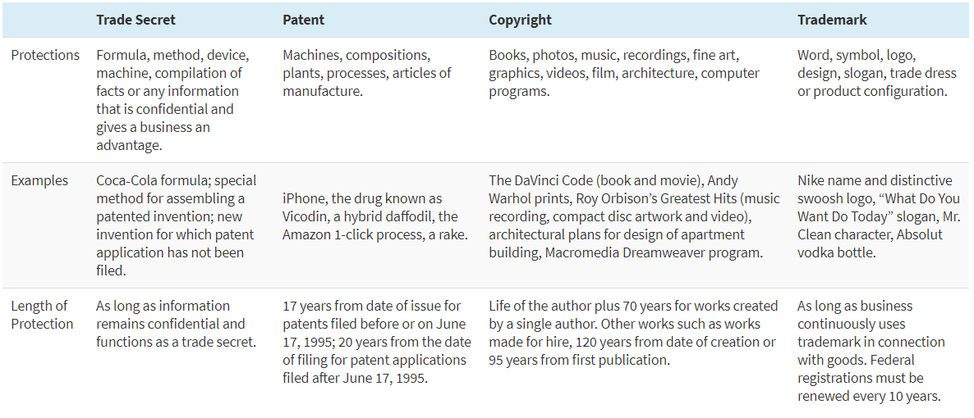
DIFFERENCE…

Slide 14

INFORMATION AND THE LAW

